Slide 1
Data Structures Day 2

Slide 2
Review
Big Idea
Why do you care?

Slide 3
Review
Do’s Don’ts

Slide 4
Review
Think about: why containers?

Slide 5
Containers
The Zebra Cake adventure
Good programs check for types
Good programmers check for types
Example 9, I had an INT and I wanted a FLOAT

Slide 6
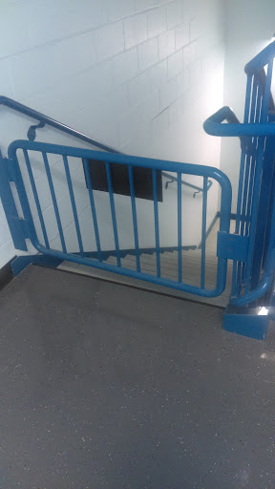
Stairwell as a container or BUS FIRE DRILL

Slide 7
Barry
20 pages on desk
file cabinet
room of file cabinets

Slide 8
Barry gets an Assistant
Chandler hands Barry papers when he asks for them.
Can Chandler predict Barry’s moves?
How good can he get?

Slide 9
CPU Read Ahead
Something like 80% of circuitry on a 64-bit CPU is committed to read-ahead
Barry has 4 assistants!
Why? Memory is slow.
$800 desktop, $400 is for i7 6700K CPU
$320 for efficient data structures

Slide 10
Run Time
How long it takes a program to run
Why this measure of time?
impactful measure of time for humans
technical problems also

Slide 11
Python
Put all files in their own directory!
Let’s look at a program together.

